Slide 1

THEME 1 - Inspiration
Download this PowerPoint Template and make your own edits

Slide 2
Explore Mars
Watch Inspiration Modules Parts I and II before beginning this section

Slide 3


What makes Mars so Interesting and Cool?
Copy & paste the text boxes and fill in your answers.
Please ONLY copy & paste the icons
Thoughtful
Enter Text Here
Enter Text Here
Enter Text Here
So cool!
Love
Unique

Slide 4
Some fun facts about Mars
There have been 59 missions to Mars - 29 were successful!
  Perseverance the rover, with Ingenuity the helicopter, launched on July 31, 2020 and landed safely on February 18th, 2021
Most Earth-like planet
Thin atmosphere, very little pressure, made of CO₂
Intense dust storms & blue sunsets
May have had an ancient global ocean

Slide 5
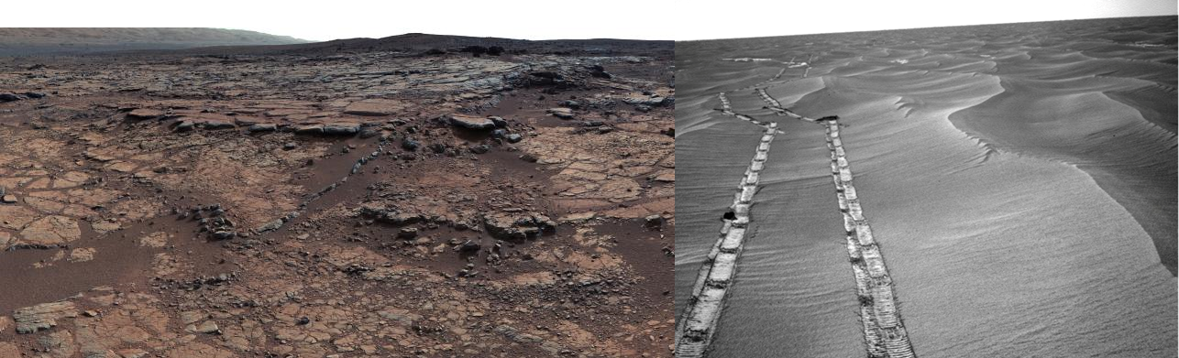
Some fun facts about Mars
Has temperatures ranging from -153 – 20 °C
Surface appears red because of iron, and is very dusty and dry

Slide 6
Some fun facts about Mars
Has the highest mountain in the Solar System, a volcano, Olympus Mons (24 km high)
Deepest valley on Mars is Valles Marineris 2-7 km deep
The North is quite flat
the South has many mountains and valleys
Has polar ice caps of dust and ice

Slide 7
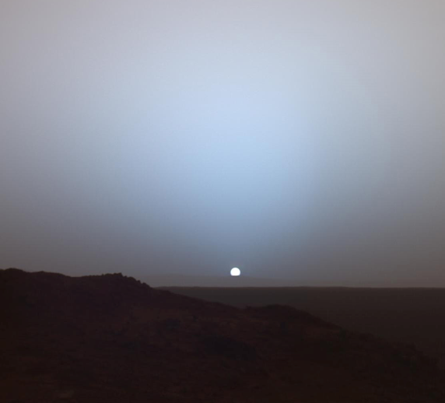
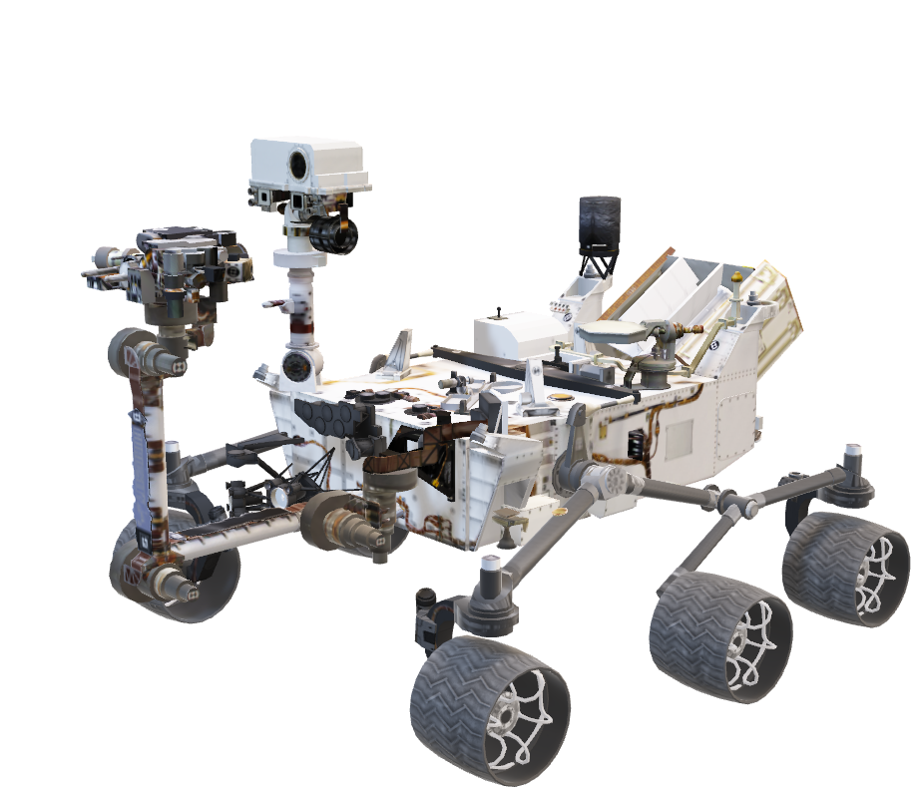
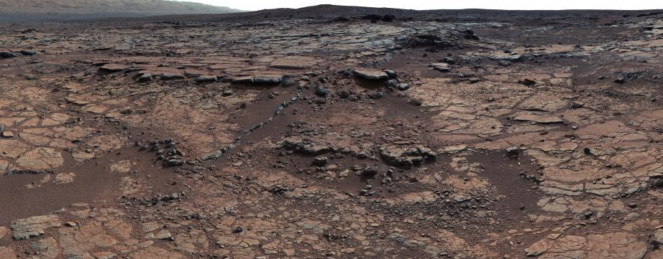
Stuck? Here are some Google suggestions!
Missions to Mars (i.e. What was the most recent one?)
What is the atmosphere and weather like?
  Fun fact: Mars has blue sunsets!
What is its surface and landscape like?
What could be some tourist attractions on Mars?
What are other fun facts about Mars?

Slide 8
2. Zero Waste
Watch Inspiration Modules Parts I and II before beginning this section

Slide 9
How can we make travel less wasteful?
Copy & paste the text boxes and fill in your answers.
Please ONLY copy & paste the icons
Thoughtful
Enter Text Here
Enter Text Here
Enter Text Here
So cool!
Love
Unique

Slide 10

















Some things to think about
Copy & paste the icons over what travel products you think are good or wasteful
Please ONLY copy & paste the icons
Good
Wasteful
Maybe?
Depends?

Slide 11
Some things to think about:
Why do we want to decrease how much waste we make?
How do we decrease waste in your everyday life?
When we go to school, a day trip, or camping, what are some things we end up throwing in the garbage? How can we avoid that?
A space trip will take a really long time, probably at least a year. How do we avoid making a lot of garbage on such a long trip from home?

Slide 12
Some things to think about:
When we go to school, a day trip, or camping, what are some things we end up throwing in the garbage? How can we avoid that?

Slide 13
3. Mind, Body & Mars
Watch Inspiration Modules Parts I and II before beginning this section

Slide 14
What cheers you up? What makes you
feel happy and healthy?
Copy & paste the text boxes and fill in your answers.
Please ONLY copy & paste the icons
Thoughtful
Enter Text Here
Enter Text Here
Enter Text Here
So cool!
Love
Unique

Slide 15





Some things to think about...
What makes you sad or frustrated or annoyed?
What makes you happy?
How do you relax?
What makes you sick?
How do you get better when you’re sick?

Slide 16
Ranking Answers
Watch Inspiration Module Part III before beginning this section

Slide 17
Which of today’s answers (yours or a past student’s) did you find the most THOUGHTFUL?

Slide 18
Which of today’s answers (yours or a past student’s) did you find the COOLEST?

Slide 19
Which of today’s answers (yours or a past student’s) did you LOVE the most?

Slide 20
Which of today’s answers (yours or a past student’s) did you find the most UNIQUE?

Slide 21
Which of these 3 Topics do you want to explore further in future sessions?
Explore Mars
Zero Waste
Mind, Body & Mars

